Slide 1
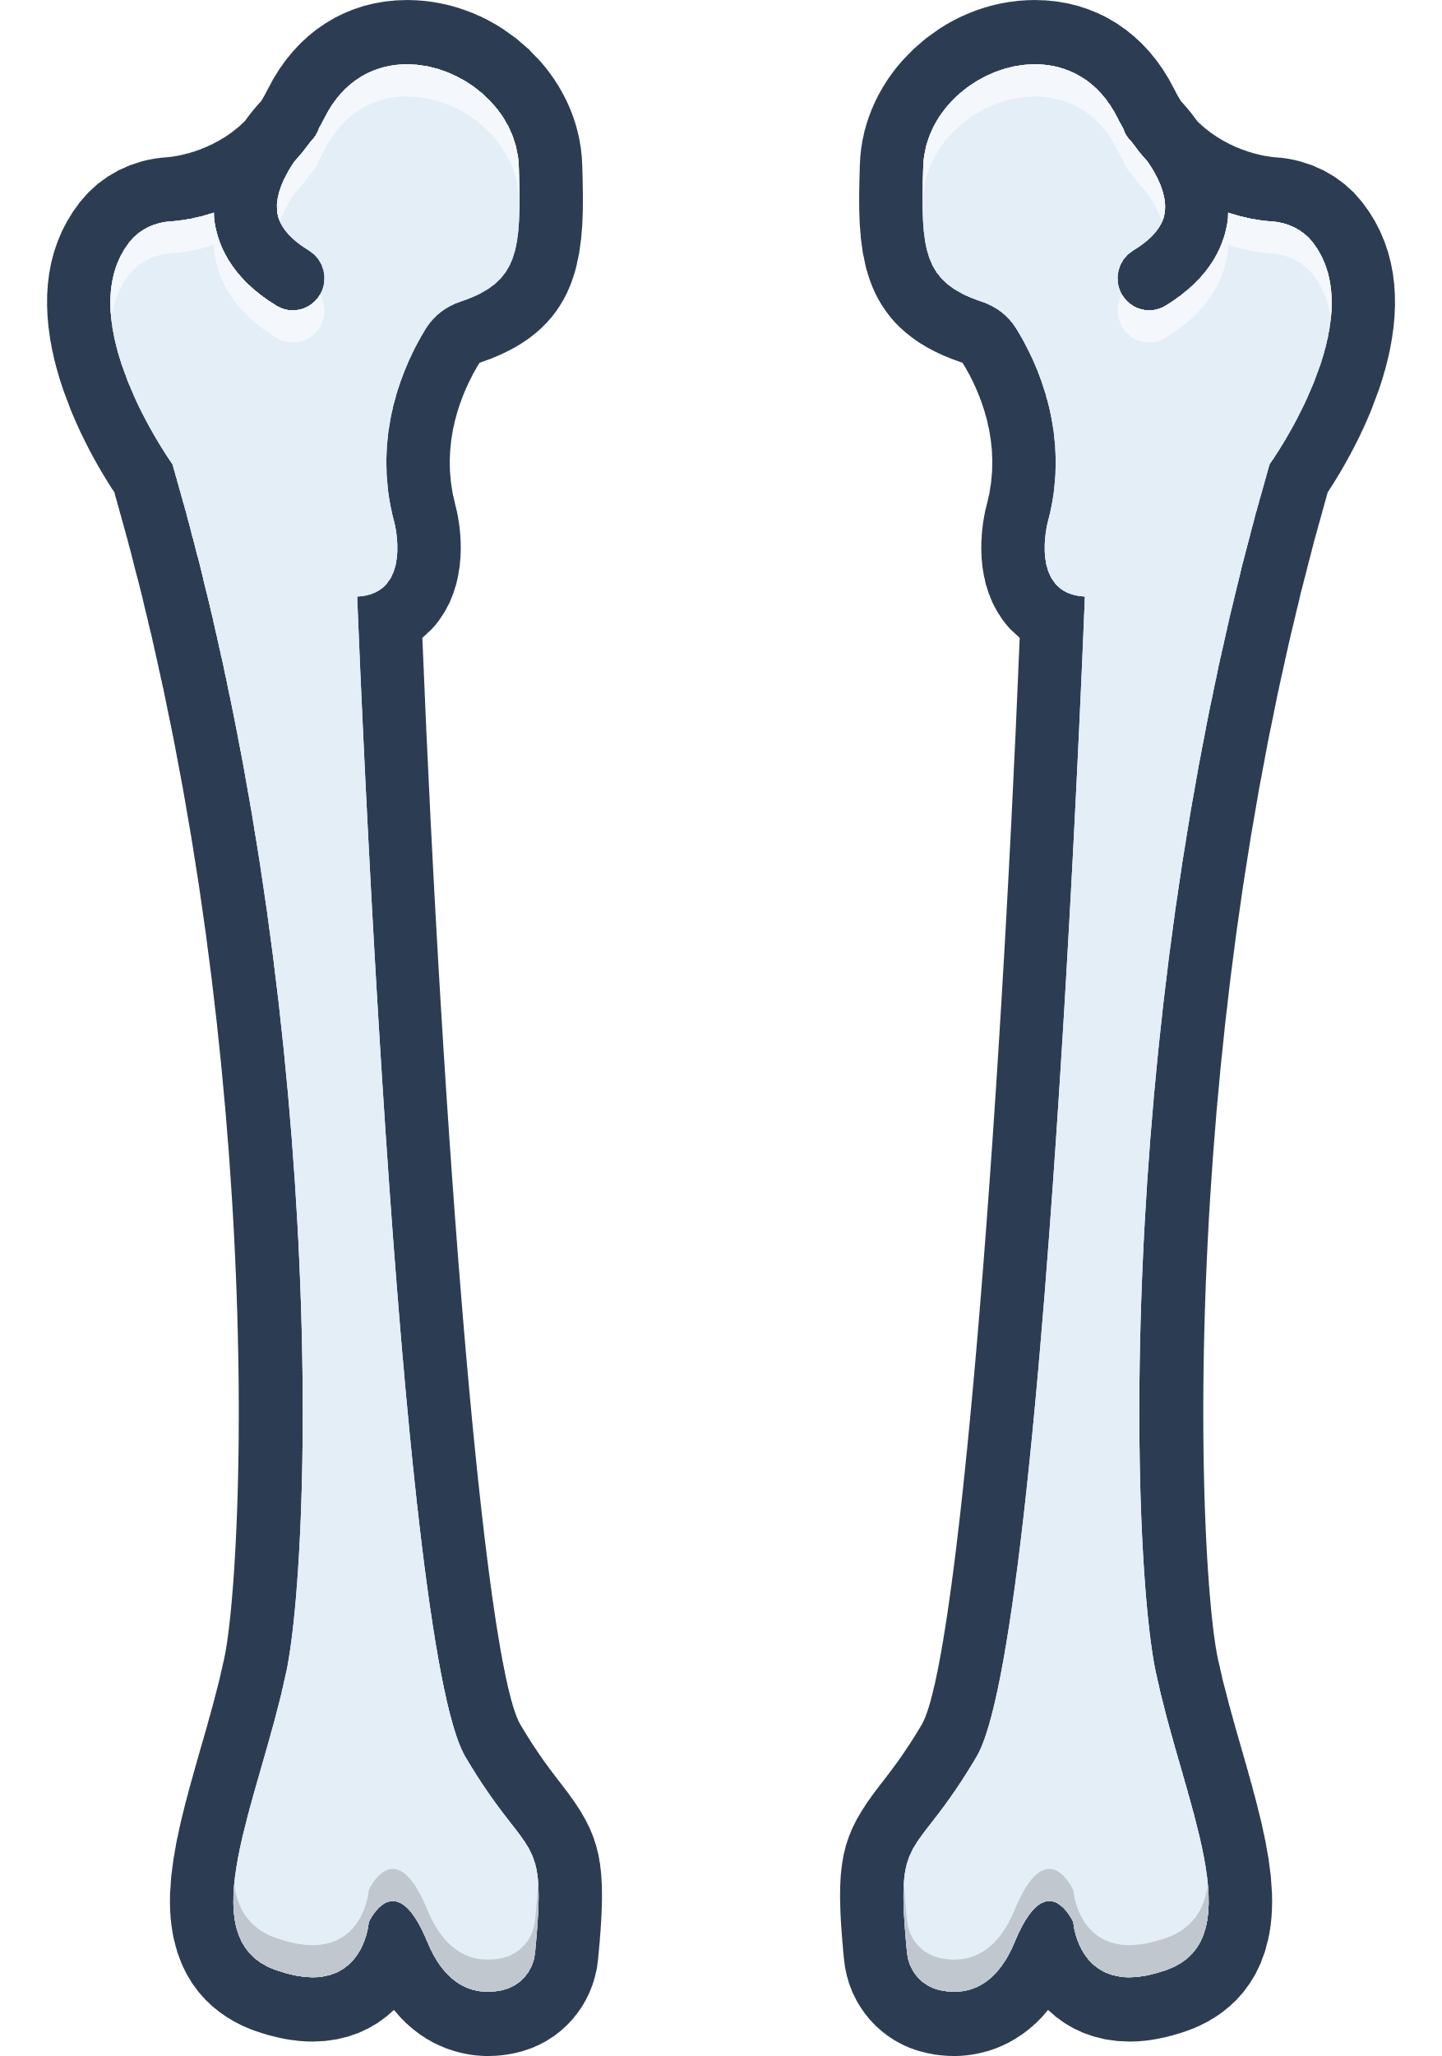
FINAL YEAR PROJECT II
Augmented Reality Exploration of Human Femur: Unveiling Fractures and Anatomy for Enhanced Understanding
Presented by: Calvin Phong Dao Jie
Supervised by: Ts. Saw Seow Hui

Slide 2
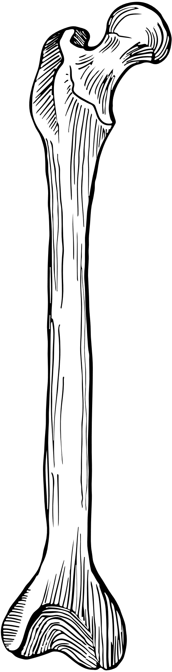
OUTLINE
AN AR EDUCATIONAL MOBILE APPLICATION FOR
FEMORAL FRACTURES
OUTLINE
01
Introduction
03
02
Literature Review
13
03
System Methodology
16
04
System Design
19
05
System Evaluation
22
06
Conclusion
28
FINAL YEAR PROJECT II

Slide 3
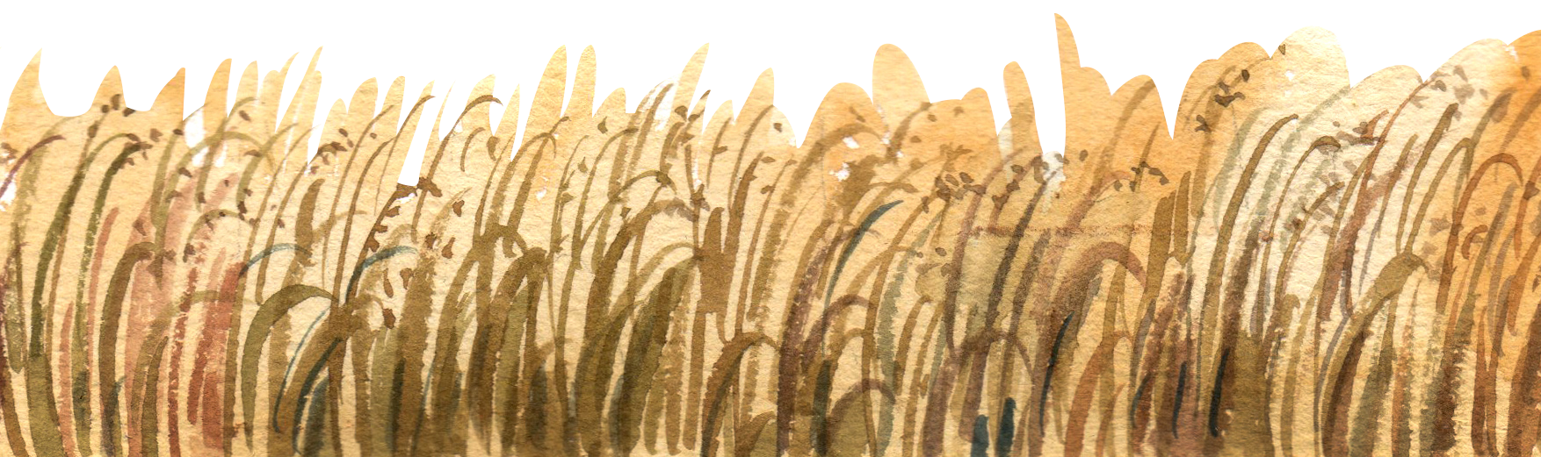
01
INTRODUCTION
Background Information
Problem Statement
Project Scope
Project Objectives

Slide 4
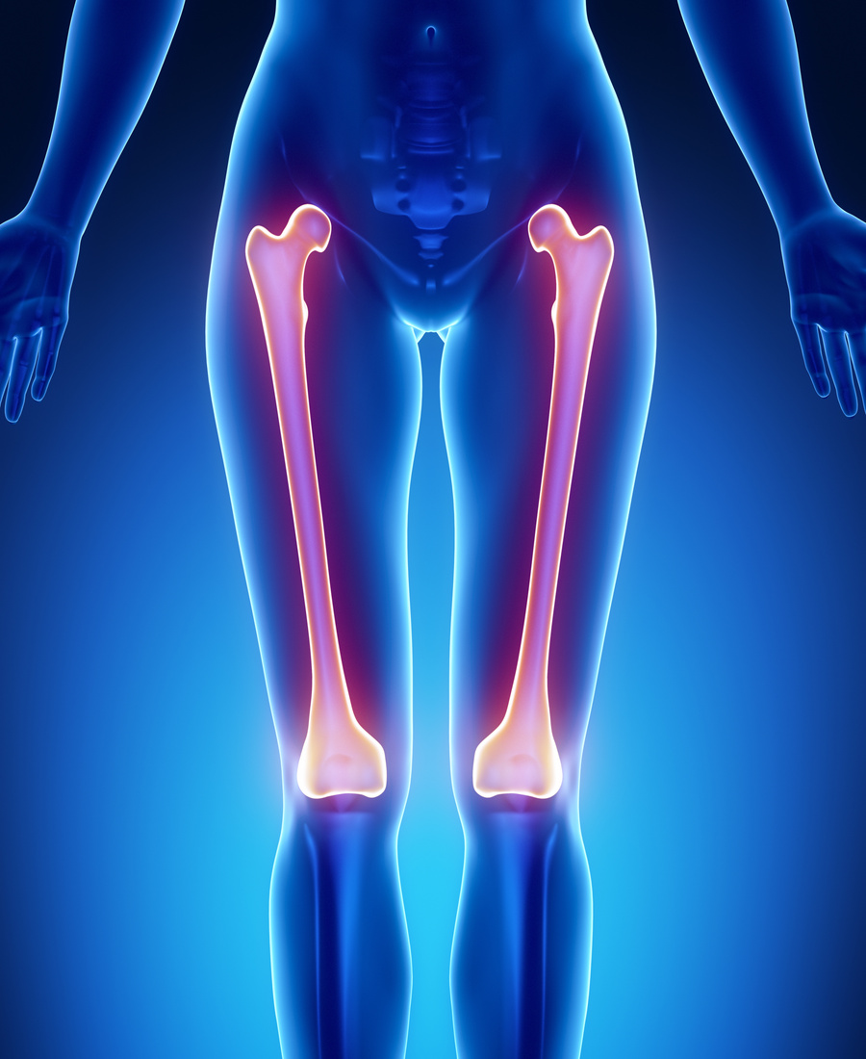
BACKGROUND INFORMATION
04
The Femur
The longest, strongest, heaviest bone in human body
Weight-bearing bone
Can resist a force of up to 1800 to 2500 pounds
(~816 kg to 1134 kg)
Stabilise pace
Also known as thigh bone
INTRODUCTION

Slide 5
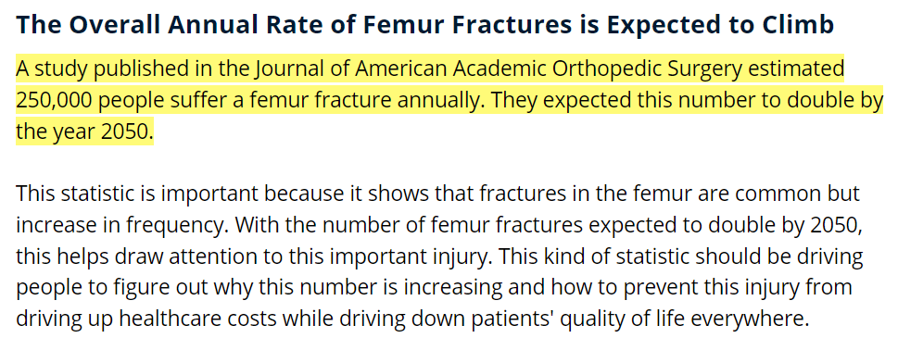
BACKGROUND INFORMATION
05
INTRODUCTION

Slide 6
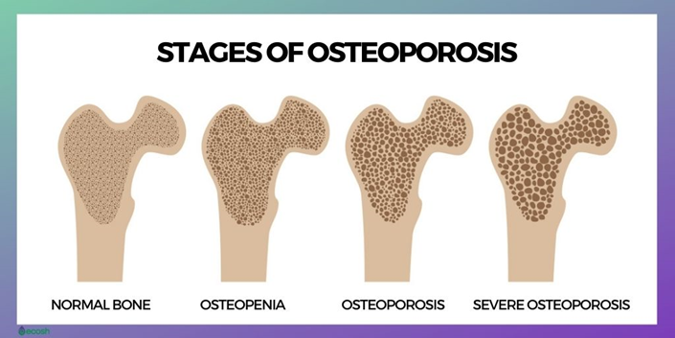
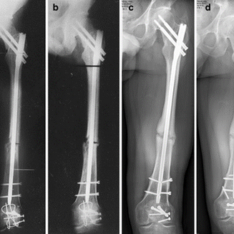
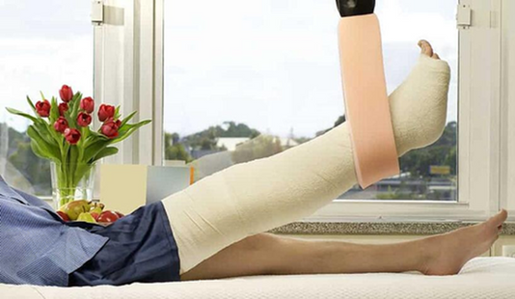
BACKGROUND INFORMATION
06
Femoral Shaft Fractures
Causes
Caused by a high-speed car collision
Fall from a great height
Osteopenia and osteoporosis
Treatment
Open reduction and internal fixation (ORIF)
Traction and casting
 | Normal | Osteopenia | Osteoporosis
T score (Bone density) | +1 to -1 | -1 to -2.5 | -2.5 and lower
INTRODUCTION

Slide 7
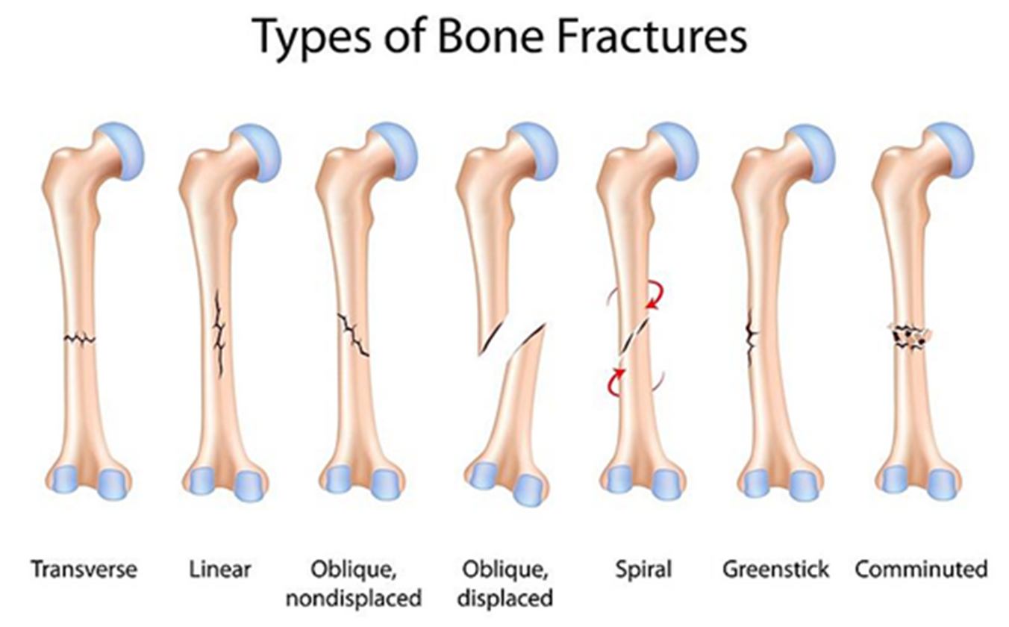
BACKGROUND INFORMATION
08
INTRODUCTION

Slide 8
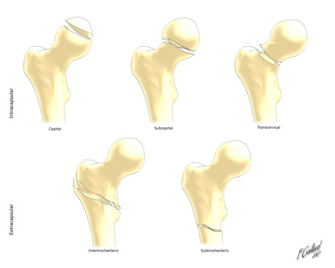
BACKGROUND INFORMATION
09
3D interactive atlas for human femur
Commonly used in multidisciplinary research for the purpose of experimental and computer simulation (Mohd Aspar, 2017)
To have a better visualization for the structure of human femur
Improve understanding
Neck Of Femur Fractures
INTRODUCTION

Slide 9

PROBLEM STATEMENT
10
01
02
03
There is no independent learning platform for human femoral shaft fractures
Existing platforms cover general anatomy but lack detailed, fracture-specific educational content.
Current resources are often costly, non-mobile, or not tailored for femur-specific learning.
INTRODUCTION

Slide 10
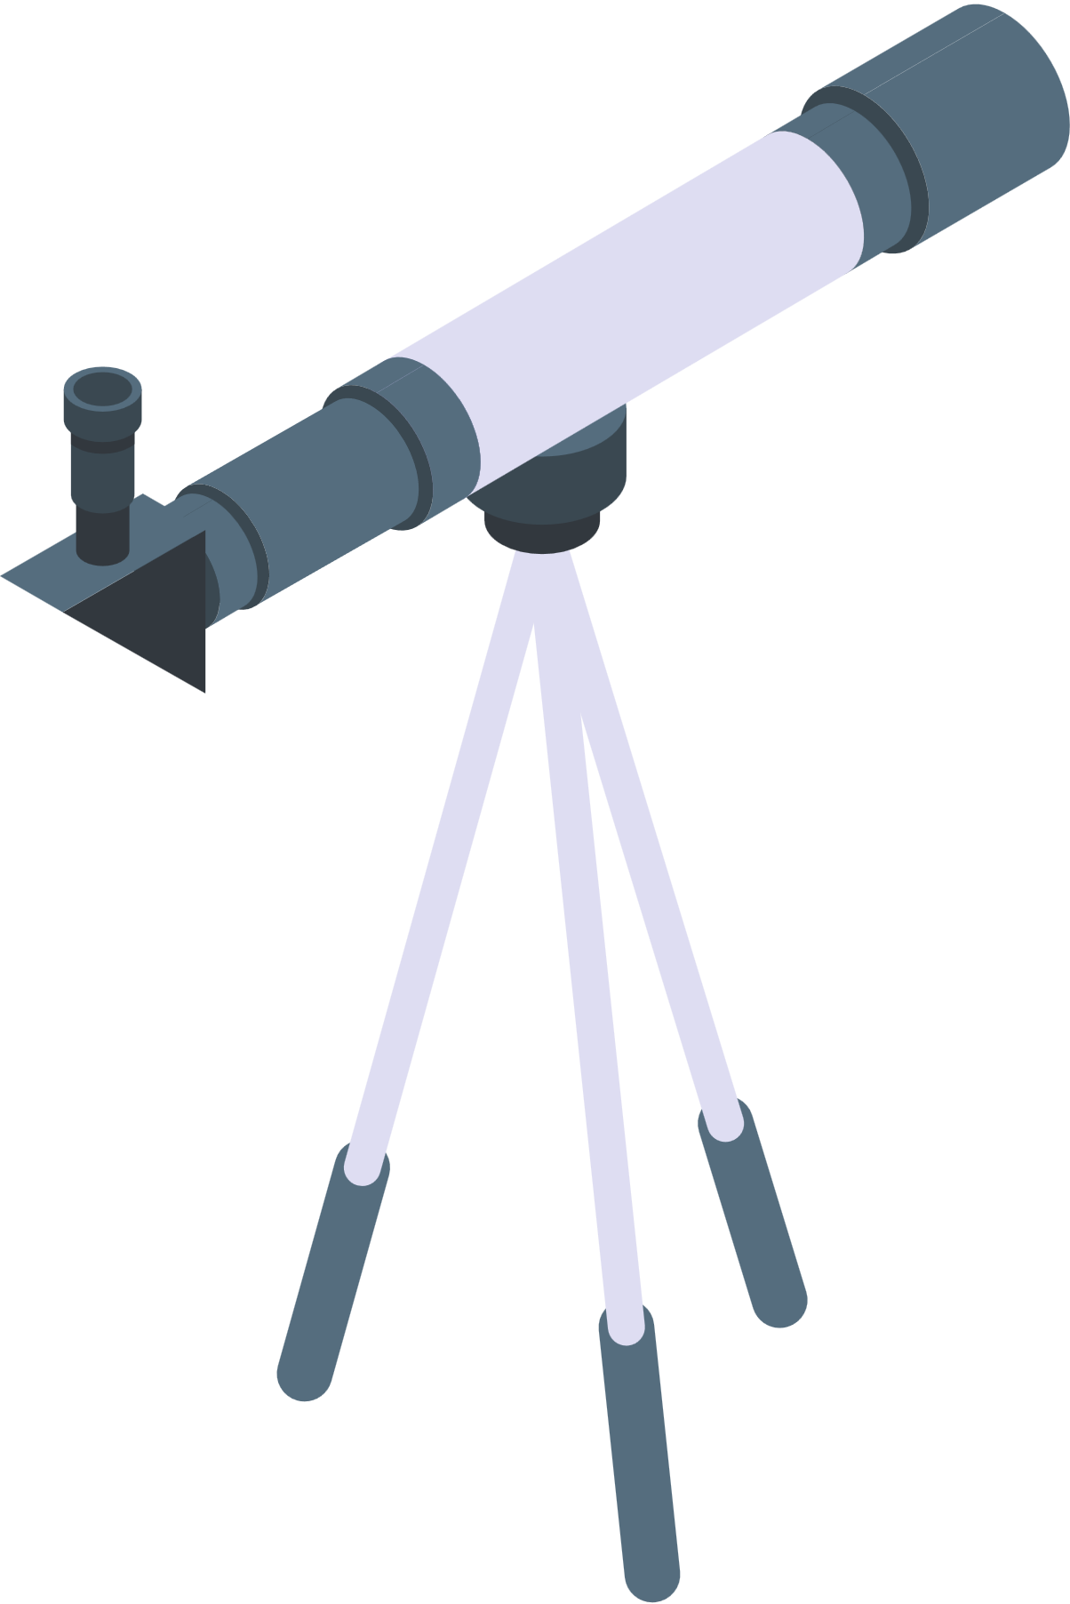
PROJECT SCOPE
11
01
02
03
Augmented Reality-Based Interaction:The application will leverage AR technology to allow users to interact with detailed 3D models of femur fractures in real-time, providing an immersive and educational experience through mobile devices.
Comprehensive Anatomical and Fracture Information:The app will offer users in-depth information about femur anatomy and various fracture types, including the ability to explore, compare, and analyze them from multiple perspectives.
Free and Accessible on Android Devices:The application will be developed specifically for Android OS to ensure wide accessibility, especially targeting students and medical enthusiasts who may have limited resources.
INTRODUCTION

Slide 11

PROJECT OBJECTIVES
12
01
02
03
Develop an Interactive AR Experience:
• Real-Time Exploration: Enable users to interact with detailed 3D models of femur fractures in real-time, providing a dynamic and immersive experience.
Provide Comprehensive Bone Information:
• Detailed Anatomy: Offer extensive information about the femur bone's structure,
Increase Application Coverage:
• Diverse Fracture Types: Incorporate a wide range of femur fracture types, from simple to complex, to cover various clinical scenarios.
INTRODUCTION

Slide 12
02
LITERATURE REVIEW
Comparison between Systems
Effects of using Mobile Application for Medical Education

Slide 13
COMPARISON BETWEEN SYSTEMS
Systems Functions | AR Anatomy | Skeleton | Complete Anatomy 2023 | Proposed Application
AR Types | Marker-Less AR | Not Implemented | Marker-Less AR | Marker-Less AR
Able to make Notes | ✖ | ✖ | ✔ | ✔
Extra Information | Clinical notes Facts | ✖ | Clinical notes Facts Treatments videos Condition videos Exercise Videos Streches Videos | ✔
Human Femoral Fractures Info | ✖ | ✖ | ✖ | ✔
Offline Available | ✔ | ✔ | ✔ | ✔
Cost | Free | Free | Costly | Free
14
LITERATURE REVIEW

Slide 14

EFFECTS OF USING MOBILE APPLICATION FOR MEDICAL EDUCATION
(Chandran et al., 2022)
15
01
02
03
Benefits:
Low cost
Increase versatility
Simulation capability
Reduce reliance on regional or site borders
Mobile application for medical education is deemed effective through a study.
Currently employed in various medical fields, most of them were web-based.
LITERATURE REVIEW

Slide 15
03
SYSTEM METHODOLOGY
Project Methodology
Technology Involved

Slide 16
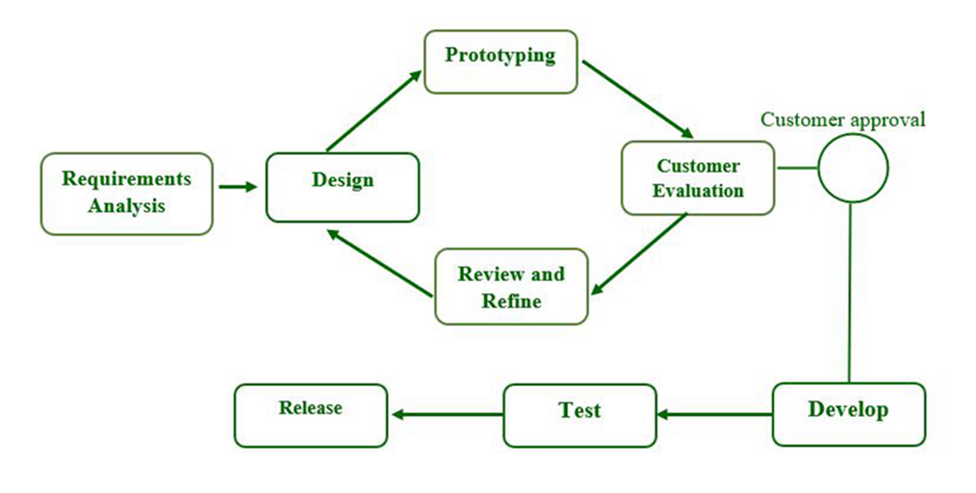
PROJECT METHODOLOGY
17
Prototype Model
SYSTEM METHODOLOGY

Slide 17




TECHNOLOGY INVOLVED
18
To create 3D bone models, then import to Unity for further development
To develop the application, such as creating UI and functions
To script out the functions for developing a complete application
SYSTEM METHODOLOGY

Slide 18
04
SYSTEM DESIGN
System Architecture Diagram
Use Case Diagram

Slide 19
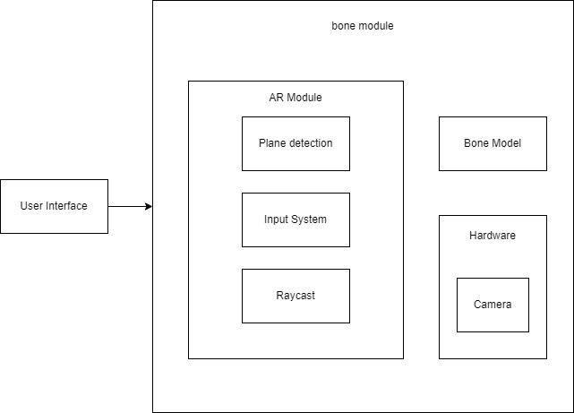
SYSTEM ARCHITECTURE DIAGRAM
20
SYSTEM DESIGN

Slide 20
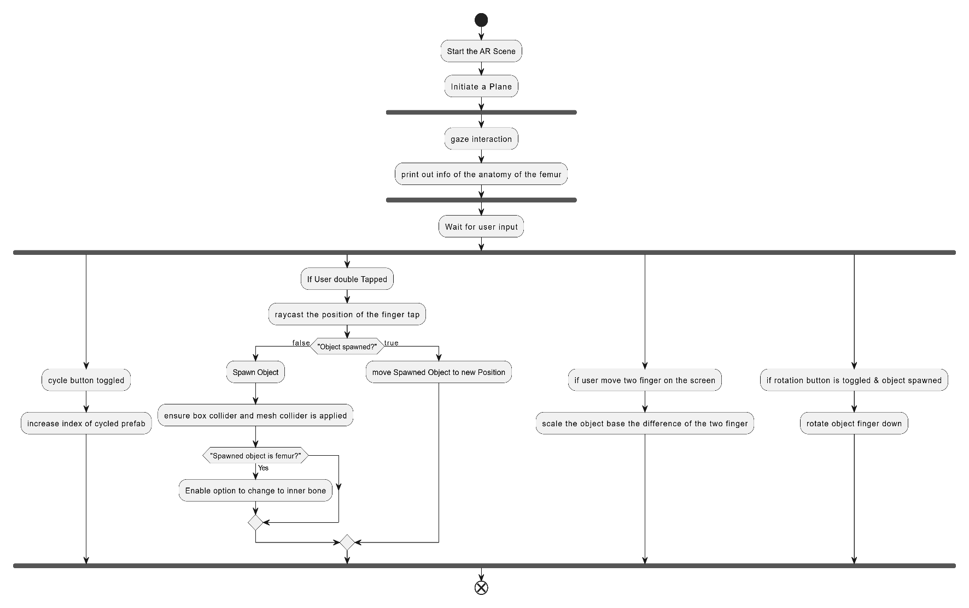
ACTIVITY DIAGRAM
21
SYSTEM DESIGN

Slide 21
05
SYSTEM EVALUATION
System Testing Methods
Results

Slide 22

SYSTEM TESTING METHODS
23
Black Box Testing
For testing the ability of some features.
Use Case Testing
For testing users’ satisfaction.
SYSTEM EVALUATION

Slide 23
Prefab Spawning Use Case
24
Use Case: Spawn Prefab on AR Plane
Actor: User
Preconditions: AR session active, plane detection enabled
Main Flow:
1. User taps on screen where AR plane is detected
2. System checks if MAX_OBJECTS limit is not reached
3. System calculates spawn position (plane position + floatHeight)
4. System instantiates selected prefab
5. System applies correct scale based on prefab index
6. System orients object towards camera
7. System updates internal object tracking
Expected Output: Prefab appears at tap position with correct scale and orientation
Alternative Flow:
1a. No plane detected at tap position
- No object is spawned
Use Case: Enforce Object Limit
Actor: System
Preconditions: MAX_OBJECTS objects already spawned
Main Flow:
1. User attempts to spawn new object
2. System checks current object count
3. System identifies oldest object
4. System removes oldest object
5. System spawns new object
Expected Output: New object appears, oldest object is removed
Alternative Flow:
1a. Object count is NOT at MAX_OBJECTS
- System spawns new object
SYSTEM EVALUATION

Slide 24
Prefab Cycling Use Case
25
Use Case: Cycle Through Prefabs
Actor: User
Preconditions: Prefab list initialized
Main Flow:
1. User presses cycle button
2. System increments SelectedPrefabIndex
3. System updates UI text
4. System shows fade panel with new prefab name
Expected Output: New prefab selected, UI updated
Use Case: Trigger Fade Panel on Prefab Cycling
Actor: User
Preconditions:
- AR session is active
- PrefabTextFader component is properly initialized
- At least one prefab is available in the prefabs list
- Current prefab is selected (SelectedPrefabIndex is valid)
Main Flow:
1. User presses the cycle button to change prefab
2. System increments SelectedPrefabIndex
3. System gets the new prefab name from prefabs[SelectedPrefabIndex].name
4. System calls prefabTextFader.ShowPrefabText(newPrefabName)
5. Fade panel displays the new prefab name
6. Fade panel animates according to its configured duration
7. Fade panel completes animation and becomes hidden
Expected Output:
- Fade panel appears with new prefab name
- Text is clearly visible
- Fade animation plays smoothly
- Panel disappears after animation completes
Use Case: Wrap Prefab Selection
Actor: System
Preconditions: Last prefab selected
Main Flow:
1. User presses cycle button
2. System increments SelectedPrefabIndex
3. System applies modulo operation
4. System updates to first prefab
Expected Output: Selection wraps to first prefab
SYSTEM EVALUATION

Slide 25
Prefab Deletion Use Case
26
Use Case: Remove Prefab from Scene
Actor: User
Preconditions: Prefab exists in scene
Main Flow:
1. User triggers delete action
2. System removes object from scene
3. System updates internal tracking
4. System updates object spawn order
Expected Output: Object removed, internal state updated
Alternative Flow:
1a. Object doesn't exist
- System logs warning
- No action taken
SYSTEM EVALUATION

Slide 26
RESULTS
27
Test Case | Use Case | Preconditions | Main Steps | Expected Result | Status
TC1.1.1 | Spawn Prefab on AR Plane | AR session active, plane detection enabled | Tap on screen → Check object count → Calculate position → Spawn prefab → Apply scale & orientation | Prefab appears at tap position with correct settings | Passed
TC1.1.2 | Enforce Object Limit | MAX_OBJECTS reached | Tap on screen → Identify oldest object → Remove oldest → Spawn new object | New object appears, oldest removed | Passed
TC1.2.1 | Cycle Through Prefabs | Prefab list initialized | Press cycle button → Increment index → Update UI text | New prefab selected, UI updated | Passed
TC1.2.2 | Wrap Prefab Selection | Last prefab currently selected | Press cycle → Increment index → Modulo operation applied | Prefab selection wraps to first item | Passed
TC1.2.3 | Trigger Fade Panel on Cycling | AR session active, fade panel initialized | Press cycle → Update index → Fetch new name → Trigger fade panel | Fade panel displays prefab name with smooth animation | Passed
TC1.3.1 | Remove Prefab from Scene | Prefab exists in scene | Trigger delete → Remove object → Update tracking and order | Prefab removed, internal state updated | Passed
SYSTEM EVALUATION

Slide 27
06
CONCLUSION

Slide 28
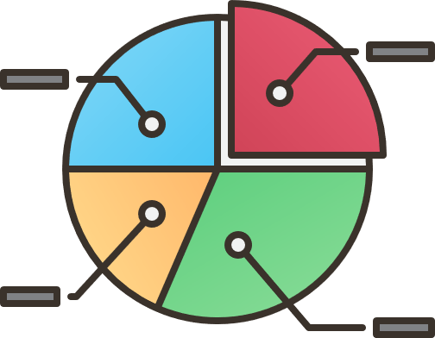
CONCLUSION
29
The project successfully developed an Augmented Reality (AR) mobile application focused on human femoral fractures.
The app addresses the lack of dedicated and accessible educational tools for femur fracture study, especially for medical students and educators.
Overall, the application contributes significantly to medical education, offering a free, accessible, and immersive learning platform.
CONCLUSION

Slide 29
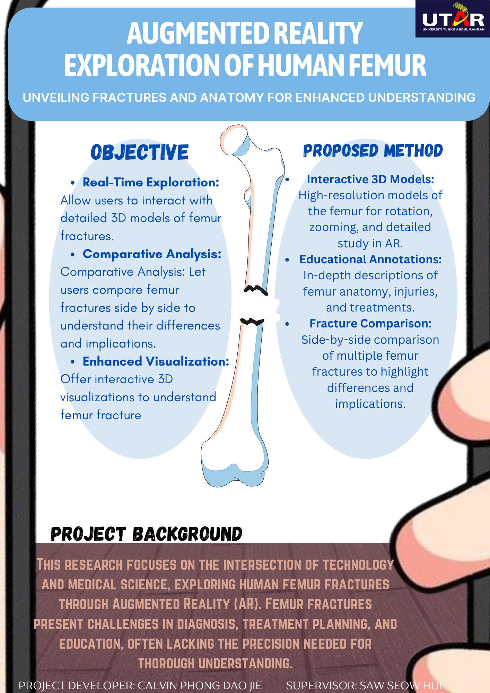
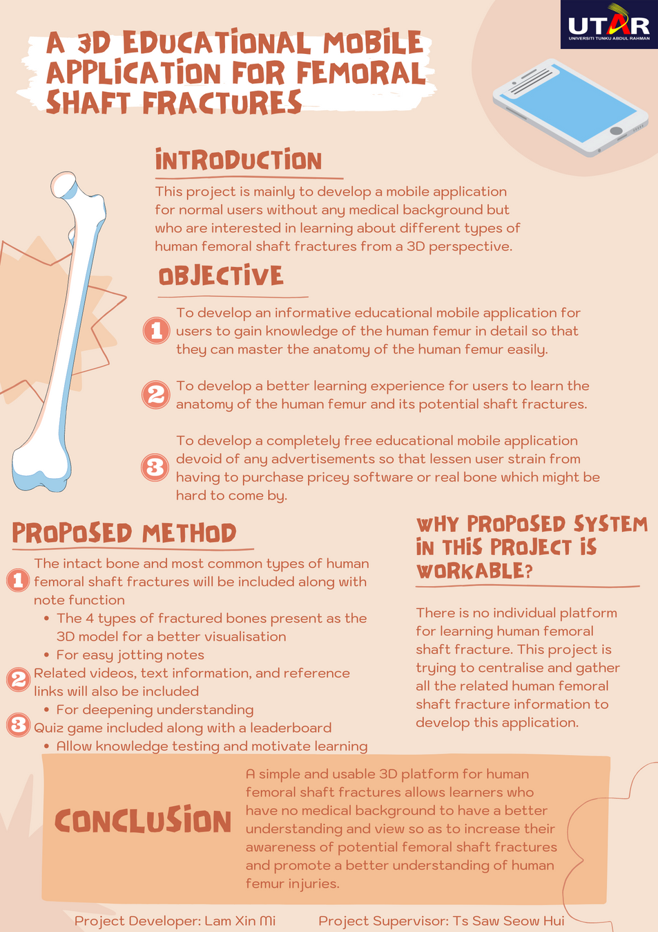
POSTER
30
POSTER

Slide 30


